Slide 1
Nordic Innovations in achieving more sustainable life by combating climate change for more sustainable future through investments in Datacenters and clean Energy

Slide 2
The cloud is getting greener, with a growing number of server farms supported by renewable power, according to a report from Greenpeace.
Greenpeace has been one of the data center industry’s toughest critics, now says it has seen meaningful improvement in the use of green energy by cloud computing platforms.
The findings were highlighted in Clicking Clean 2017, the latest
report on cloud sustainability.
Despite being educated, many young job seekers lack
the skills they need to get the jobs they want.
Cultural agility and technological integration = Key professional assets of today

Slide 3
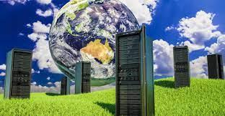
HOW ARE DATA CENTERS ADDRESSING SUSTAINABILITY?
Companies are appointing dedicated young employers to drive corporate sustainability objectives and to reporting publicly on the evolution of those efforts.
Companies have taken to heart the phrase “Reduce, Reuse, Recycle” (The Three R’s).
The Data Center industry adopted The Three R’s as guiding principles for meeting the economic, environmental, and social aspects of sustainability.
Beyond the Three R’s, all of the leading Data Centers have committed to transitioning away from carbon-based and nuclear generated power in favour of renewable energy from wind, solar, and hydroelectric facilities.
In the data center industry, leaders such as Apple, Google, Microsoft, AWS, Facebook, and Equinix have all taken a visibly strong stance on sustainability.

Slide 4
DATA CENTER CLEAN ENERGY POLICY
Facebook, Microsoft and Google are a few of the technology companies that have committed to go ‘100% renewable’ through the RE100 .
RE100 is the global corporate renewable energy initiative bringing together hundreds of large and ambitious businesses committed to 100% renewable electricity.

Slide 5
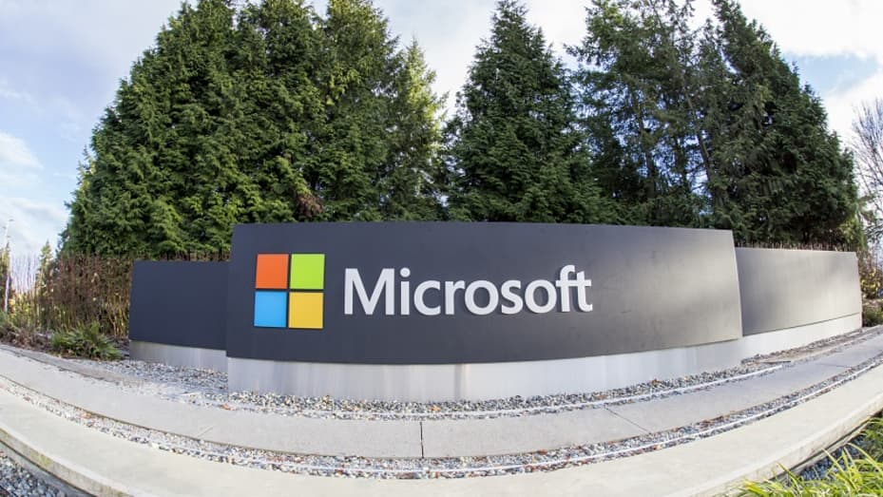
Earlier this year, Microsoft announced plans to switch to a 100 percent renewable energy supply for all its data centers, buildings, and campuses by 2025.
It also plans to become carbon negative by 2030 and remove the equivalent of all its past carbon emissions by 2050
Microsoft plans to open new sustainable Data Centers in Sweden this year to meet increasing demand for cloud services in the country.

Slide 6
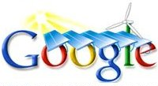
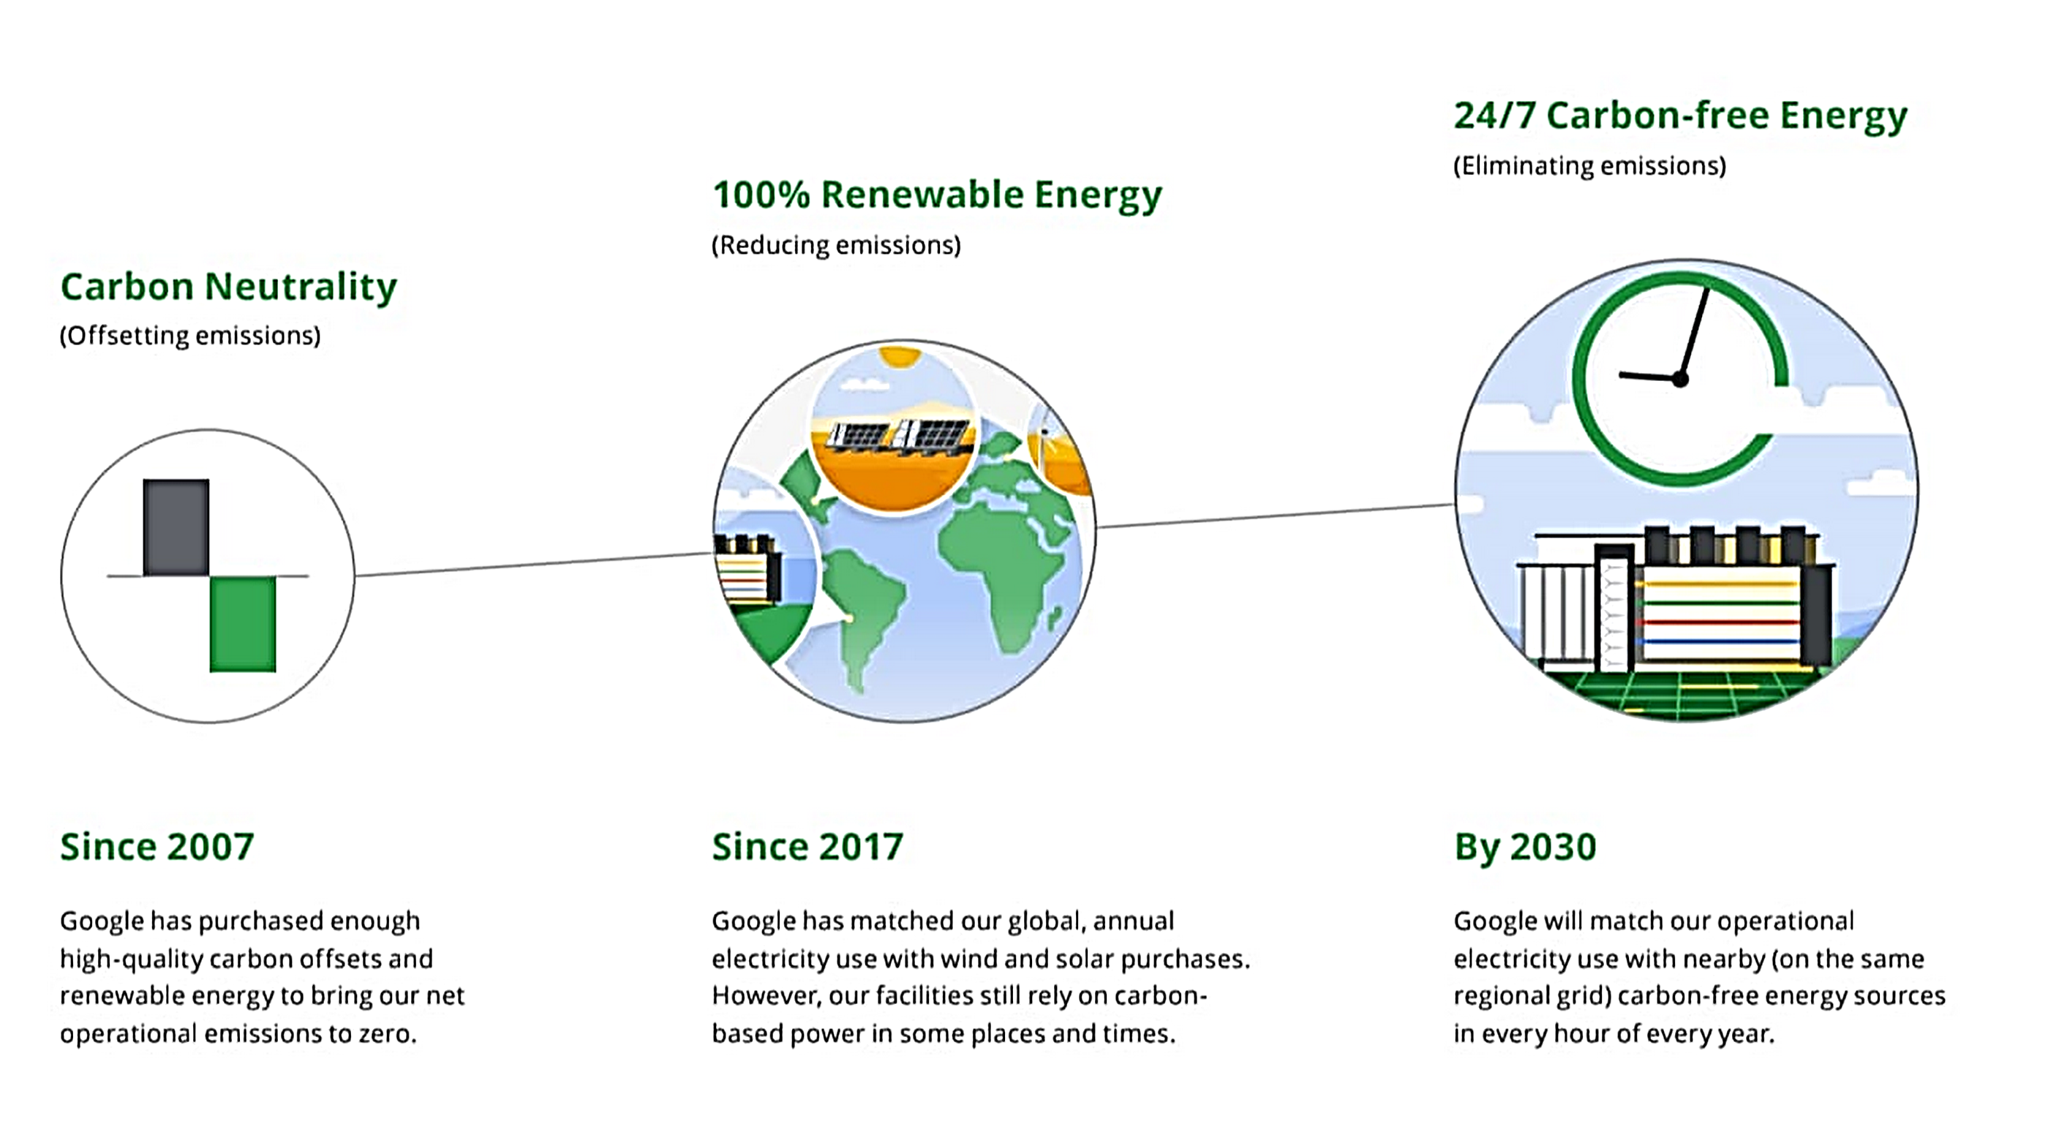
Tackling climate change requires rapidly transitioning the entire global
economy to clean energy and Google Cloud will be at the forefront
of this transition.
Google has a long track record on clean energy.
Today, Google Cloud is the only Major cloud provider to purchase enough renewable energy to cover its entire operations, and over the years, we’ve purchased more wind and solar power than any other corporation in history.
In September 14, 2020, Google set our most ambitious energy goal yet: to run our business on carbon-free energy everywhere, at all times, by 2030. This means Google is aiming to always have its data centers supplied with carbon-free energy. Google is the first cloud provider to make this commitment, and intends to be the first to achieve it, too.

Slide 7
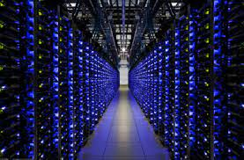
REASONS TO BUY FROM BIG DATA CENTERS PROVIDERS
Big cloud providers build there Data Centers with efficiency and clean energy in mind.
Main goal = Saving natural resources for the future generations.
Data Center Providers have extensive Sustainability Programs for old Data Centers and for all new Data Centers.
Individual data centers are more costly and cause more wasteful energy consumption.
Collective Data Centers allow better energy management.
Long term objective = all energy would become renewable.

Slide 8
End
THANK YOU
Janne Rajala
Senior Cloud and Enterprise Architect
Onrego Oy
https://onrego.fi/en/home/

