Slide 1
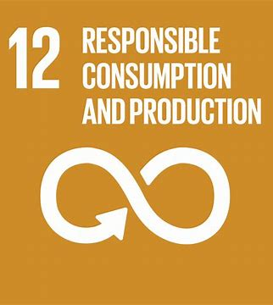
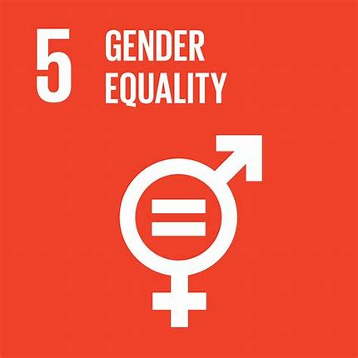
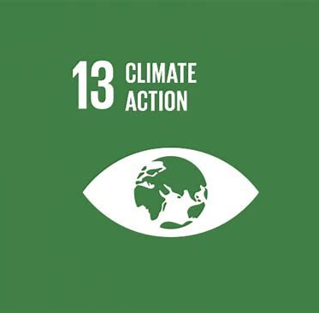
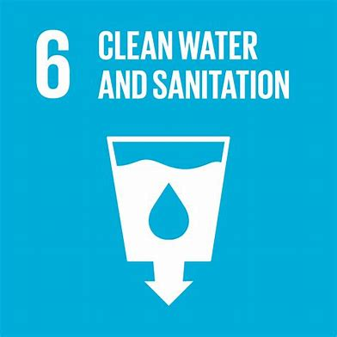
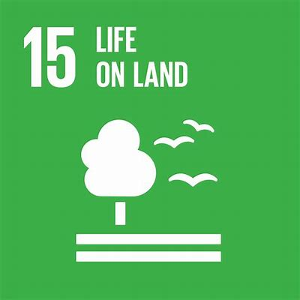
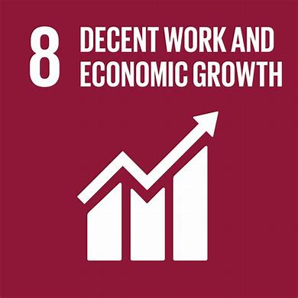
How sustainable fashion habits can resolve the Climate Emergency
By Abigail Wordsworth
Notes:
Hello everyone, my name is Abi and I am the founder of ‘News to Reuse’ an anti-fast fashion campaign that educates people on the impacts of fashion on both people and the environment, and to also hold these brands accountable. I am also a Youth Ambassador for I Have A Voice- a social enterprise which shows young people how they can engage with the political system, hold elected officials to account and make their voices heard across a range of pressing social challenges.
WHAT IS FAST FASHION? Fast fashion is defined as inexpensive clothing products rapidly produced by mass market retailers in response to the latest trends.
Let’s take a look as to why this business model is so bad.

Slide 2
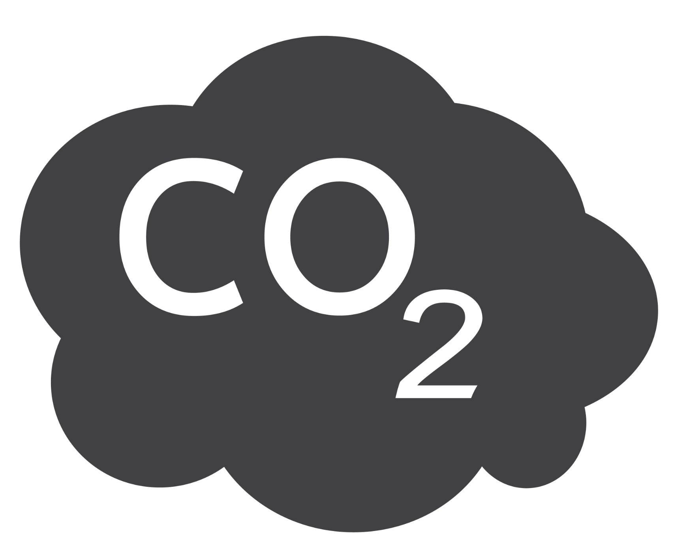
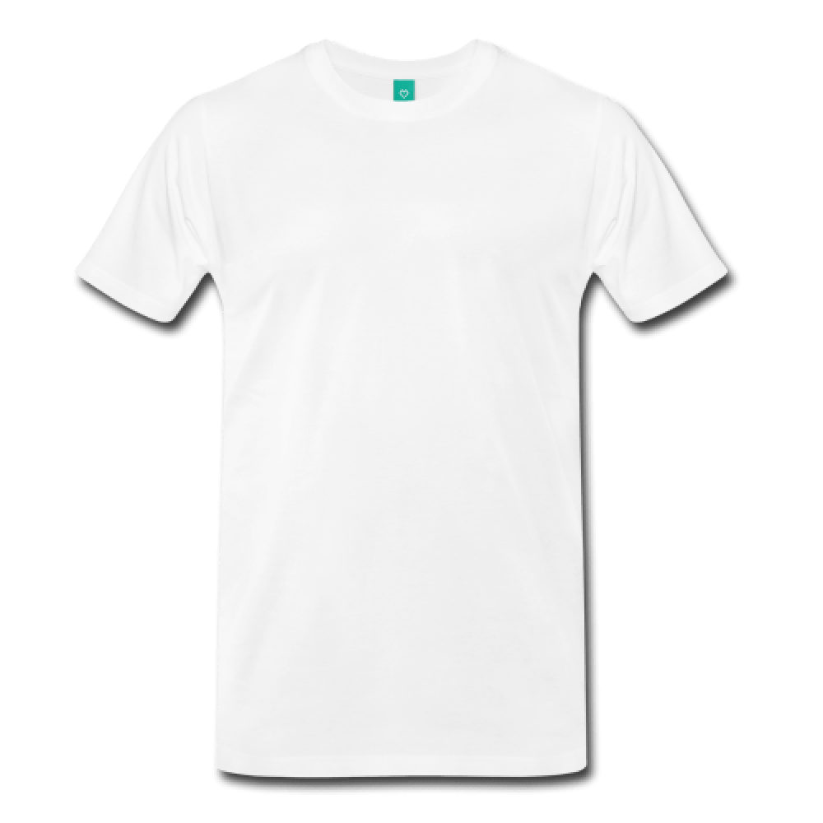
Buying just one white cotton shirt produces the same amount of emissions as driving 35 miles in a car.
35 miles
The textile industry produces more greenhouse gas emissions than the shipping and aviation industries combined.

Slide 3
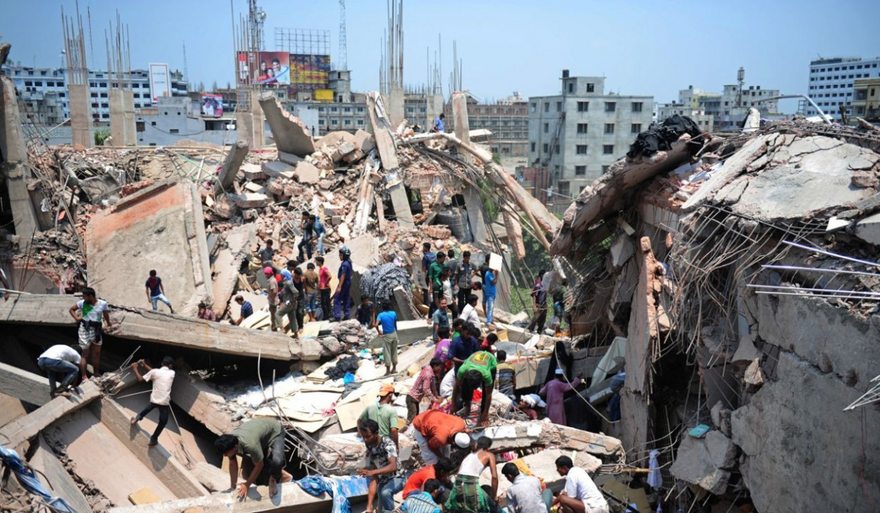
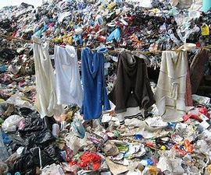
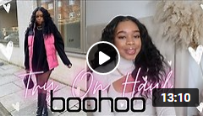
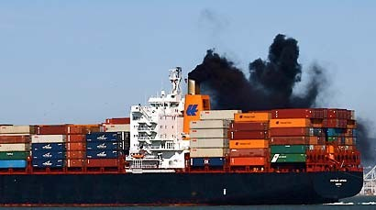
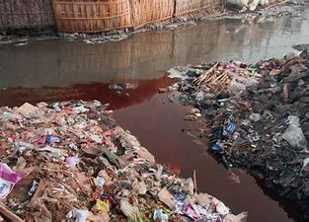
Consumer habits need to change.
One in six young people say that they don’t feel they can wear an outfit again once it’s been seen on social media.
Overconsumption is on the rise, with the average garment lasting just 7 wears.
Notes:
It’s clear that consumer habits need to change, and they need to change now.
The UN sustainable development goals are undoubtedly hindered by fast fashion, with each section of the supply chain, from the extraction of raw materials, to manufacturing and shipping having associated impacts such as high co2 emissions, chemical leaching. Not only does fast fashion have environmental impacts, but also causes social devastation. (Rana Plaza factory collapse in Bangladesh, which had a death toll of 1,134)
The unprecedented growth of social media and the “ideal” image perpetuated by influencers exacerbates the impacts as there is a certain pressure to fit in, which often requires keeping up with trends at the expense of the environment and garment workers.

Slide 4
Education
Whilst the climate crisis as a topic briefly appears in Science, Geography and Textiles, it is often overlooked. As a result, children lack vital knowledge on how their habits can impact the climate.
All children should know about:
Climate change/ global warming
The Global Waste Trade
Sewing/ mending (and other simple solutions- reduce, reuse, recycle)
The problems with consumerism in the Western World
Sustainability should be a mandatory subject in schools.
Notes:
Even if methods are in place to enforce positive change within the industry, education- or a lack of- is a huge barrier to true sustainability. If consumers were aware that their own shopping habits is what leads to this destruction then they could possibly change their behaviour accordingly by buying less or choosing sustainable items.
After the sobering Intergovernmental Panel on Climate Change report, it is clear that education is important now more than ever.
The type of education i have just spoken about is very traditional and almost a text-book approach, which I’m sure many young people can attest to- isn’t always interesting, engaging or impactful. Therefore it is important that young people take a creative approach to sustainability. Social media, despite fostering fast fashion trends and enforcing unrealistic standards, can be a positive force for change and a channel to spread awareness through campaigning and lobbying. Organisations like I Have A Voice which educate and empower youth through work experience and campaigning are vital.

Slide 5
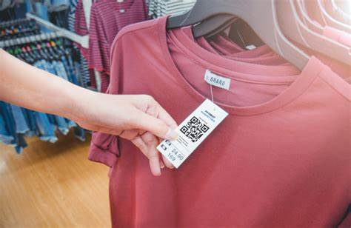
2. QR Codes on labels
This would be and accessible and easy way for consumers to:
View the carbon footprint of a garment before they buy it
See what materials have been used
See the factory it was made in and if the worker is paid a decent wage.
Consumers would be well informed and able to make the most ethical choice with one scan.
Brands must be more transparent with consumers.
Notes:
Given that the fashion industry is set to take up 26% of the carbon budget by 2050 we think it is vital that the public is given this tool to enable the consumer to make the most ethical and educated purchase possible.
Furthermore brand transparency will hopefully force these companies’ hand into making more environmentally conscious choices within their production and supply chain- in order to salvage their reputation.

Slide 6
3. Green technology funding
Developed countries have a moral duty to implement green technology.
Traditional light bulbs to LED or CFL lights
Investment in solar panels
Reusing waste products
Brands must commit to funding and researching green technology to improve the environment and the lives of garment workers.
Notes:
We understand the manufacturing process can’t be stopped- and it would be hugely unfair to damage the economies of developing countries, especially as one of the UN75 declarations is to “leave no one behind”
So we want high income countries to use their privilege of being a global leaders in tackling climate change and having a clear plan to reach net zero by 2050, to support these countries and their governments. These green technologies would greatly benefit manufacturing countries abroad.
How great would it be if there was a sort of green technology bank that companies such as Amazon invested in?
To summarise, sustainable education, the use of QR codes and green technology funding will all encourage a circular economy- meeting a host of UN SDGs
I wouldn’t say I am an expert, i’m just passionate about the environment. But we don’t just need experts, we need enthusiasts. We need this generation of young people to be adequately educated and clued up on the issues that are so pressing in modern society so that they themselves can be climate activists and reverse some of the damage already done by global warming.
If the pandemic has taught us anything that disasters do happen. People will die due to global warming and its subsequent impacts. But it also shows us that when countries, organisations and people work together in harmony, great things can be achieved.

